Slide 1
CS 355/555
Probability and Statistics for CS
Baocheng Geng
Lecture 12, 2/12/2023
CS 355/555 Probability and Statistics for CS

Slide 2
Test 1
Next Friday 2/21 (in class)
Close book close note (One cheat sheet allowed)
Friday: exercises, next week: review and solutions
Schedule accommodations
Copyright Statement
CS 355/555 Probability and Statistics for CS

Slide 3



Introduction
Expectation 2.4
Introduction
Expectation
Variance
CS 355/555 Probability and Statistics for CS

Slide 4
Copyright Statement
Copyright Statement
Materials prepared for and/or included in this course are protected by copyright law. They are intended to be used only by students enrolled in this course during the current term and should not be further disseminated without prior permission from the course instructor.
CS 355/555 Probability and Statistics for CS

Slide 5

Expectation
Expected Value
The expected value of a random variable X with Probability Mass Function p_{X} (x) is defined as
E(X) = xp (x)
X
Also called mean and expectation.
CS 355/555 Probability and Statistics for CS
4/23 08:17

Slide 6
Expectation - Example 2.2
We toss an unfair coin twice with P(X = head) = ³ on one throw.
4
What is the expected number of heads?
CS 355/555 Probability and Statistics for CS

Slide 7
Expectation - Example 2.2
P(X = head) = ³
4
HH TH
TH TT
CS 355/555 Probability and Statistics for CS
6/23 08:17

Slide 8
Expectation - Example 2.2
P(X = head) = ³
4
HH TH
TH TT
( )
3
2
×
1 3
4
4 4
( )
2
×
1 3
1
4 4
4
CS 355/555 Probability and Statistics for CS
6/23 08:17

Slide 9
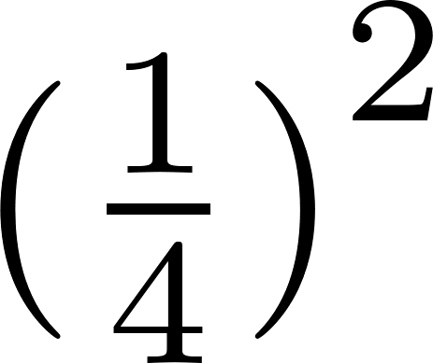
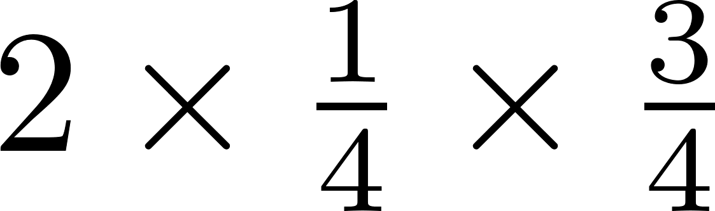
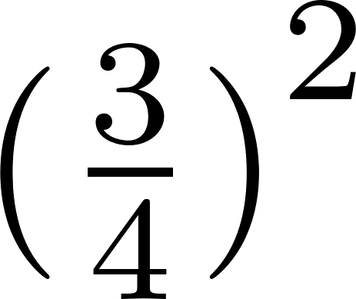
Expectation - Example 2.2
P(X = head) = ³
4
HH TH
TH TT
( )
3
2
×
1 3
4
4 4
( )
2
×
1 3
1
4 4
4
if t = 0 if t = 1
if t = 2
p_{X} (t) =
CS 355/555 Probability and Statistics for CS
6/23 08:17

Slide 10
Expectation - Example 2.2
1
16
if t = 0
p (t) =
6
16
if t = 1
X
9
16
if t = 2
CS 355/555 Probability and Statistics for CS
7/23 08:17

Slide 11
Expectation - Example 2.2
1
16
if t = 0
p (t) =
6
16
if t = 1
X
9
16
if t = 2
1
6
9
16
E(X) = 0 × + 1 × + 2 ×
16
16
CS 355/555 Probability and Statistics for CS
7/23 08:17

Slide 12
Expectation - Example 2.2
1
16
if t = 0
p (t) =
6
16
if t = 1
X
9
16
if t = 2
1
6
9
16
E(X) = 0 × + 1 × + 2 ×
16
16
24 3
= =
16 2
CS 355/555 Probability and Statistics for CS
7/23 08:17

Slide 13
Expectation - Example 2.2
E(X) is the idea of center of gravity.

Slide 14
Expectation - Example 2.2
CS 355/555 Probability and Statistics for CS
8/23 08:17

Slide 15
Expectation - Example 2.2
E(X) is the idea of center of gravity.
CS 355/555 Probability and Statistics for CS
8/23 08:17

Slide 16
Expectation - Example 2.2
Throw one six sided die.
x | p_{X} (x)
1 | 1 6
2 | 1 6
3 | 1 6
4 | 1 6
5 | 1 6
6 | 1 6
CS 355/555 Probability and Statistics for CS

Slide 17
Expectation - Example 2.2
Throw one six sided die.
x | p_{X} (x)
1 | 1 6 | 1 6
2 | 1 6 | 2 6
3 | 1 6 | 3 6
4 | 1 6 | 4 6
5 | 1 6 | 5 6
6 | 1 6 | 6 6
CS 355/555 Probability and Statistics for CS

Slide 18
Expectation - Example 2.2
Throw one six sided die.
x | p_{X} (x)
1 | 1 6 | 1 6
2 | 1 6 | 2 6
3 | 1 6 | 3 6
4 | 1 6 | 4 6
5 | 1 6 | 5 6
6 | 1 6 | 6 6
 |  | 21 6
7
E[X] = = 3.5
2
CS 355/555 Probability and Statistics for CS

Slide 19
Expectation
CS 355/555 Probability and Statistics for CS

Slide 20
Expected Value of Uniform Random Variable
Expected Value
Average of Uniform RV
X = {n, n + 1, n + 2, ..., n + m}
Average:
n + (n + m)
µ_{X} =
2
Proof:
CS 355/555 Probability and Statistics for CS

Slide 21
Indicator Variable
Indicator Variable
The indicator variable for an event A is a variable having value 1 if the A happens, and 0 otherwise.
CS 355/555 Probability and Statistics for CS
14/23 08:17

Slide 22
Indicator Variable
Indicator Variable
The indicator variable for an event A is a variable having value 1 if the A happens, and 0 otherwise.
The number of times something happens can be written as a sum of indicator variables.
CS 355/555 Probability and Statistics for CS
14/23 08:17

Slide 23

Indicator Variable
I flip a coin n times. Each flip is a random variable X_{i}, 1 ≤ i ≤ n
1 if the i^{th} toss is a head
0 if the i^{th} toss is a tail
X_{i} =
The number of heads is
X
i
CS 355/555 Probability and Statistics for CS
15/23 08:17

Slide 24

Indicator Variable
I flip a coin n times. Each flip is a random variable X_{i}, 1 ≤ i ≤ n
1 if the i^{th} toss is a head
0 if the i^{th} toss is a tail
X_{i} =
The number of heads is
X
i
The expected number of heads in 1 toss then is
1 1 1
0 × + 1 × =
2
2 2
CS 355/555 Probability and Statistics for CS
15/23 08:17

Slide 25
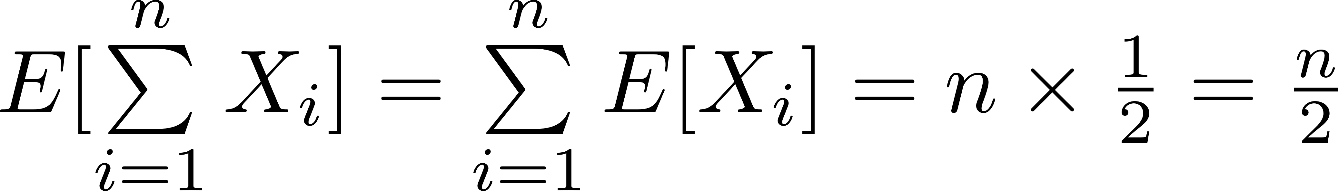
Indicator Variable
I flip a fair coin n times. Each flip is a random variable X_{i}, 1 ≤ i ≤ n
1 if the i^{th} toss is a head
0 if the i^{th} toss is a tail
X_{i} =
The expected number of heads in n tosses then is
CS 355/555 Probability and Statistics for CS

Slide 26
Expectation
Expected Value
The expected value of a function g(X) of a random variable X with Probability Mass Function p_{X} (g(x)) is defined as
E(g(X)) = g(x)p (x)
X
CS 355/555 Probability and Statistics for CS

Slide 27
Expectation
Expected Value
E(g(X)) = g(x)p (x)
X
Let g(X) = X² where X is the value on a fair six sided die.
x | g(x) | p_{X} (x) | g(x)p(x)
1 | 1 | 1 6 | 1 6
2 | 4 | 1 6 | 2 3
3 | 9 | 1 6 | 3 2
4 | 16 | 1 6 | 8 3
5 | 25 | 1 6 | 25 6
6 | 36 | 1 6 | 6
 |  |  | 91 6
CS 355/555 Probability and Statistics for CS

Slide 28
Variance
Variance
The variance var(X) of a random variable X with Probability Mass Function p_{X} (x) is defined as
var(X) = E [ (X − E[X])² ]
CS 355/555 Probability and Statistics for CS
5/27 08:17

Slide 29
Variance
Variance
The variance var(X) of a random variable X with Probability Mass Function p_{X} (x) is defined as
var(X) = E [ (X − E[X])² ]
Variance can be zero, but it cannot be negative.
CS 355/555 Probability and Statistics for CS
5/27 08:17

Slide 30
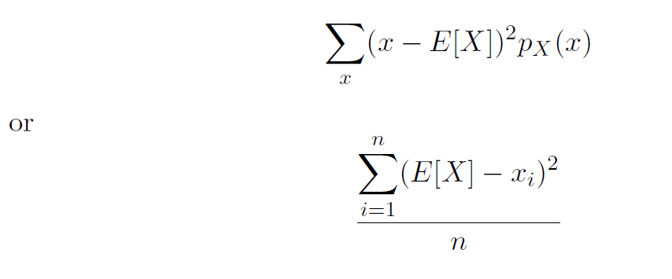
Variance
Variance is usually calculated
CS 355/555 Probability and Statistics for CS

Slide 31
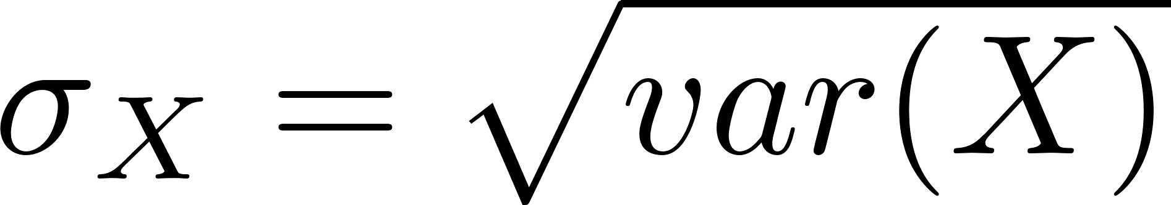
Standard Deviation
Standard Deviation
The standard deviation σ_{X} of a random variable X is defined as
Note that units for σ_{X} are the same as units for X.
Also note the different notations. Sometimes var(X) is written σ² .
X
CS 355/555 Probability and Statistics for CS
9/27 08:17

Slide 32

Variance in Statistics
n
(E[X] − x )
2
i
var(X) = ^{i=1}
n
CS 355/555 Probability and Statistics for CS
10/27 08:17

Slide 33
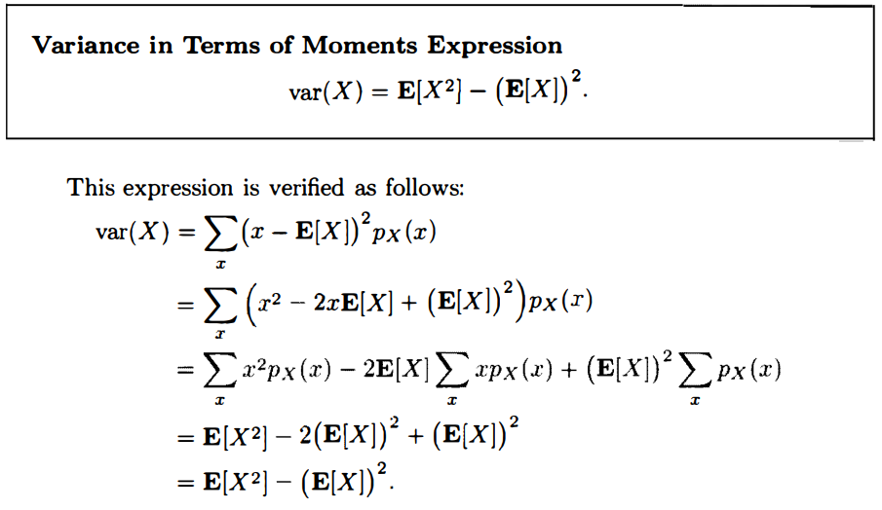
Properties of Mean and Variance (p87)
CS 355/555 Probability and Statistics for CS
10/27 08:17

Slide 34
Properties of Mean and Variance (p86)
If random variable Y is a linear function of X: Y = aX+b
CS 355/555 Probability and Statistics for CS
10/27 08:17

Slide 35
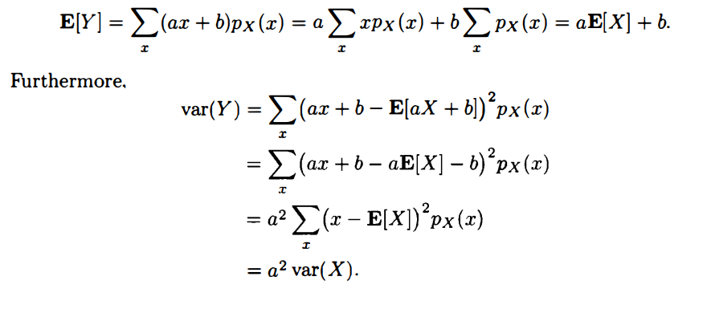
Properties of Mean and Variance (p86)
If random variable Y is a linear function of X: Y = aX+b
CS 355/555 Probability and Statistics for CS
10/27 08:17

Slide 36
Mean and Variance for Uniform Distribution
X = {n, n + 1, n + 2, ...n + m} = {a, ..., b}
Average =
n + (n + m) a + b
µ =
=
2 2
CS 355/555 Probability and Statistics for CS

Slide 37
Variance for Uniform Distribution
If X ∈ [1, n], then var(X) is calculated
var(X) = E[X²] − (E[X])²
CS 355/555 Probability and Statistics for CS

Slide 38
Variance for Uniform Distribution
Simplify a little and assume X ∈ [1, n], each integer equally likely. If
X ∈ [1, n], then E[X²] is calculated
1
2
E[X ] = (n + 1)(2n + 1)
6
CS 355/555 Probability and Statistics for CS
16/27 08:17

Slide 39
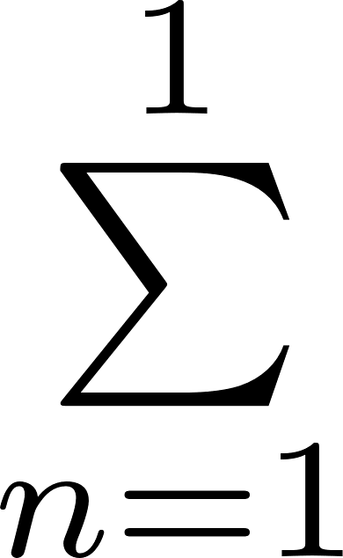
Variance for Uniform Distribution
Simplify a little and assume X ∈ [1, n], each integer equally likely. If
X ∈ [1, n], then E[X²] is calculated
1
2
E[X ] = (n + 1)(2n + 1)
6
Proof by induction: For n=1,
1
1
2 2
E[X ] = n = (1 + 2)(1 + 1) = 6 = 1
6
6
Suppose true for some n ≥ 1
CS 355/555 Probability and Statistics for CS
16/27 08:17

Slide 40
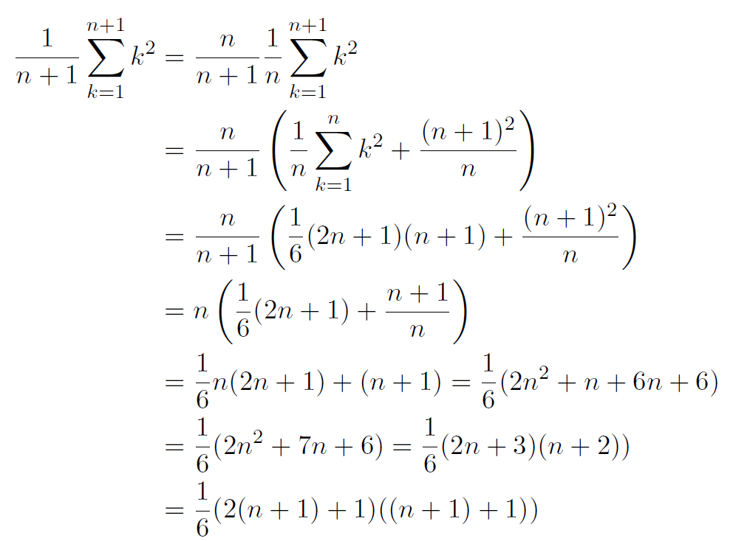
Variance
CS 355/555 Probability and Statistics for CS
17/27 08:17

Slide 41
Variance
var(X) = E[X²] − (E[X])²
CS 355/555 Probability and Statistics for CS
18/27 08:17

Slide 42
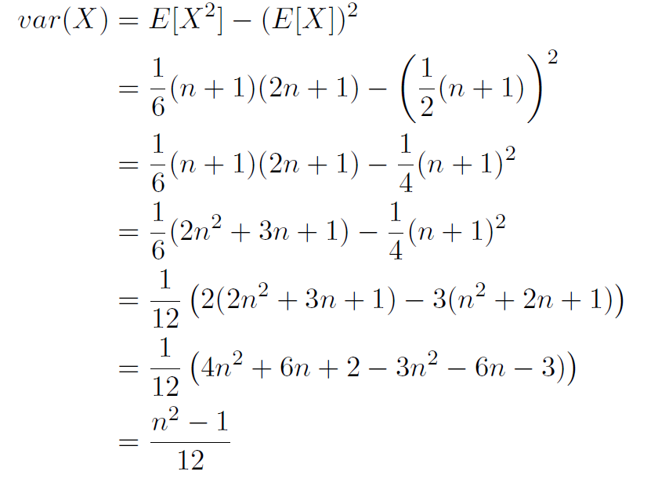
Variance
CS 355/555 Probability and Statistics for CS
18/27 08:17

Slide 43
Example 2.3
Look at Example 2.3, page 84-85, and work it out using [−4, 4]. Then redo it using [−40, 40].
CS 355/555 Probability and Statistics for CS

Slide 44
Expected Value
X a geometric Random Variable, with probability p,
1
p
E[X] =
CS 355/555 Probability and Statistics for CS

Slide 45
Var(X)
1 − p
var(X) =
_{p}2
CS 355/555 Probability and Statistics for CS

Slide 46
Geometric Example
Let p = ¹
4
1
E[X] = = 4
p
1 − p 1 −
1
4 ₌
3
4
var(X) =
_{p}2
=
× 16 = 12
1
16
CS 355/555 Probability and Statistics for CS
22/27 08:17

Slide 47
Bernoulli Random Variable
Example 2.5 pg 88
Toss a coin with probability of heads p.
p if k = H
p (k) =
X
1 − p if k = T
E[X] = 1 × p + 0 × (1 − p) = p E[X²] = 1² × p + 0² × (1 − p) = p
var(X) = E[X²] − (E[X])² = p − p² = p(1 − p)
CS 355/555 Probability and Statistics for CS

Slide 48
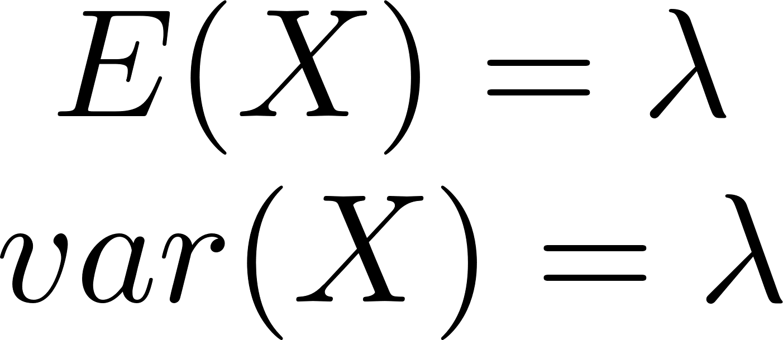
Poisson Random Variable Mean
Example 2.7, page 90. Here’s the PMF for Poisson
p_{X} (k) = e
−λ ^{λk}
k!
CS 355/555 Probability and Statistics for CS
24/27 08:17

Slide 49
Expected Value and Variance
Page 123 some interesting problems.
Problem 21 St. Petersburg paradox Problem 22, 23
CS 355/555 Probability and Statistics for CS
26/27 08:17

Slide 50
Next Class
Exercises
CS 355/555 Probability and Statistics for CS
27/27 08:17

